Slide 1
Pathogenic Bacteria and Key Diseases
DR FRANCIS O. AGYAPONG

Slide 2
Learning Objectives
Appreciate the concept of Normal Flora of the human body
Explain Key mechanisms of disease
Link organisms to common clinical syndromes
Outline basic diagnostic and treatment principles

Slide 3
Normal Flora
Normal flora organisms that inhabit the body surfaces exposed to the environment, such as the skin, oropharynx, intestinal tract, and vagina.
Members of the normal flora differ in number and kind at various anatomic sites
Members of the normal flora are low-virulence organisms.
They are nonpathogenic in their usual anatomic sites
Generally, viruses and parasites are not recognized as part of normal flora of the human body

Slide 4
Members of Human Normal Flora
Skin-the predominant member of the normal flora of the skin is Staphylococcus epidermidis. It is an important cause of infections of prosthetic heart valves and prosthetic joints.
Staphylococcus aureus is also present on the skin, but the nose is its site. It causes abscesses in the skin and in many other organs
Oropharynx. The main members of the normal flora of the mouth and throat are the viridans streptococci.
Viridans streptococci are the most common cause of subacute endocarditis.

Slide 5
Members of Human Normal Flora
Gastro-intestinal tract - The two most important members of the colonic flora that cause disease are the anaerobe Bacteroides fragilis and the facultative Escherichia coli.
Vagina - Lactobacilli are the predominant normal flora organisms in the vagina.
They keep the pH of the vagina low, which inhibits the growth of organisms such as Candida albicans, an important cause of vaginitis

Slide 6
Members of Human Normal Flora
Urethra - the outer third of the urethra contains a mixture of bacteria, primarily S. epidermidis.
The female urethra can become colonized with fecal flora such as E. coli, which predisposes to urinary tract infections.

Slide 7
Role of the Normal Flora
They can cause disease particularly in immunocompromised and debilitated individuals.
They constitute a protective host defense mechanism.
The nonpathogenic resident bacteria occupy attachment sites on the skin and mucosa that can interfere with colonization by pathogenic bacteria. The ability of members of the normal flora to limit the growth of pathogens is called colonization resistance.
If the normal flora is suppressed, pathogens may grow and cause disease.
They may serve a nutritional function.
The intestinal bacteria produce several B vitamins and vitamin K.

Slide 8
When do normal human flora cause disease
Barrier breakdown (Staph aureus causing wound infections)
Immunosuppression (HIV, chemotherapy, steroids, malnutrition, extremes of age)
Disruption of normal flora (broad spectrum antibiotics, overgrowth of resistant or opportunistic organisms eg Clostridiodes difficile)
Translocation to abnormal or unusual sites (eg E coli causing UTI)
Overgrowth due to favourable conditions (pH changes, hormones, nutrients) eg vaginal candidiasis after antibiotics or pregnancy
Foreign bodies encouraging bioflm formations (Staph. epidermidis causing device-related infections)

Slide 9
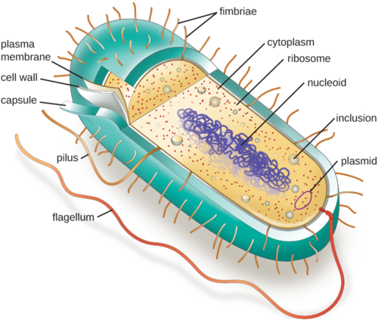
Structure of typical bacterial pathogen

Slide 10
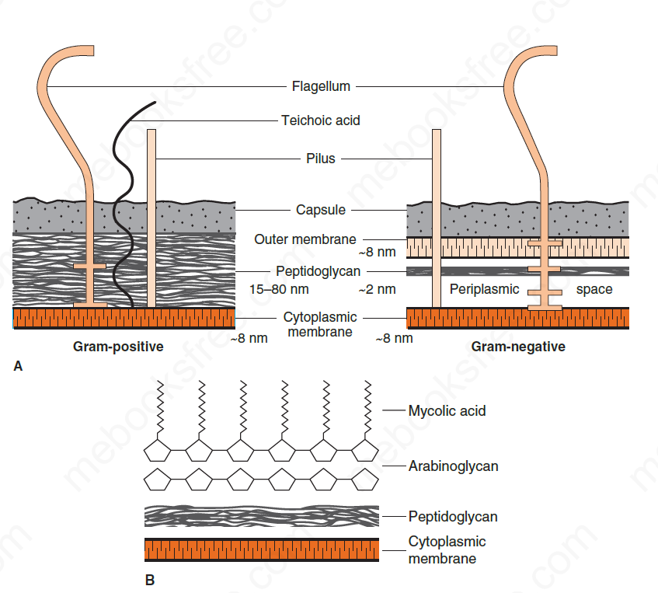
Structure of typical bacterial pathogen cell wall

Slide 11
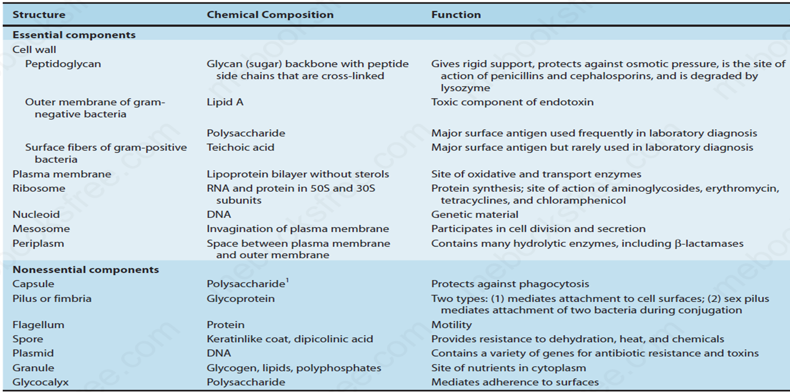
Structure of typical bacterial pathogen

Slide 12
Bacterial Disease Pathogenesis
Pathogenesis is the process by which a disease or disorder develops
Infectious disease is established when microorganisms over-power the host defences
There is usually a complex inter-play of factors between the host and the infecting microorganism before disease is established
From the Infecting organism’s perspective, the two critical determinants in overpowering the host are
the number of organisms to which the host, or person, is exposed and
the virulence of these organisms.

Slide 13
Stages of Bacterial Pathogenesis
Bacterial infection could be acquired from an external source or from the normal flora of the host
A generalized sequence of the stages of infection is as follows:
Transmission into the portal of entry.
Adherence to mucous membranes.
Evasion of primary host defences such as skin or stomach acid.
Colonization – growth of the bacteria at the site of adherence.
Disease symptoms caused by toxin production or invasion or immunopathogenesis accompanied by inflammation.
Host responses, both nonspecific and specific immunity
Progression or resolution of the disease

Slide 14
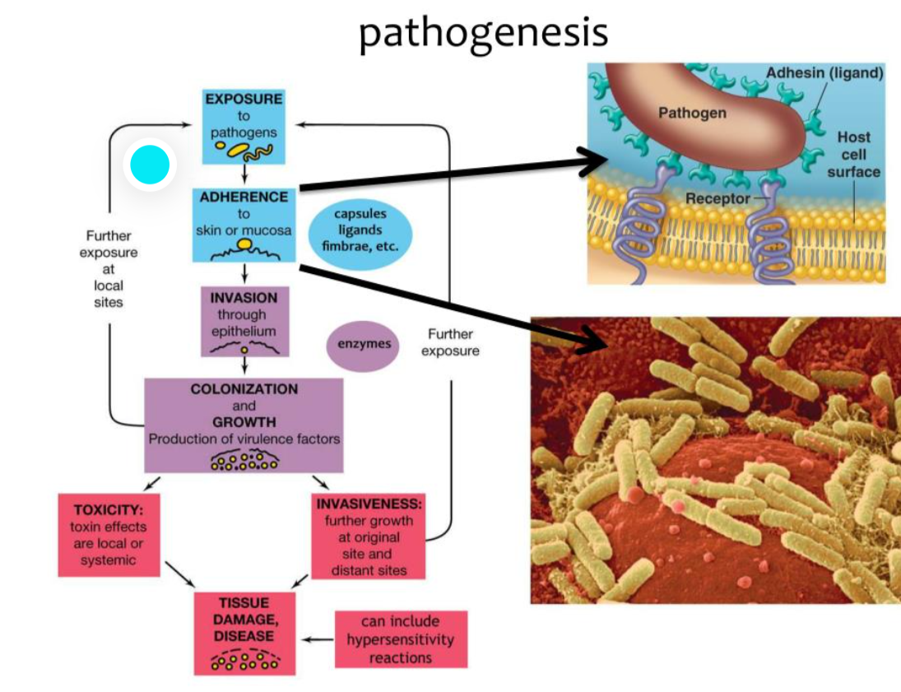
Bacterial Disease Pathogenesis

Slide 15
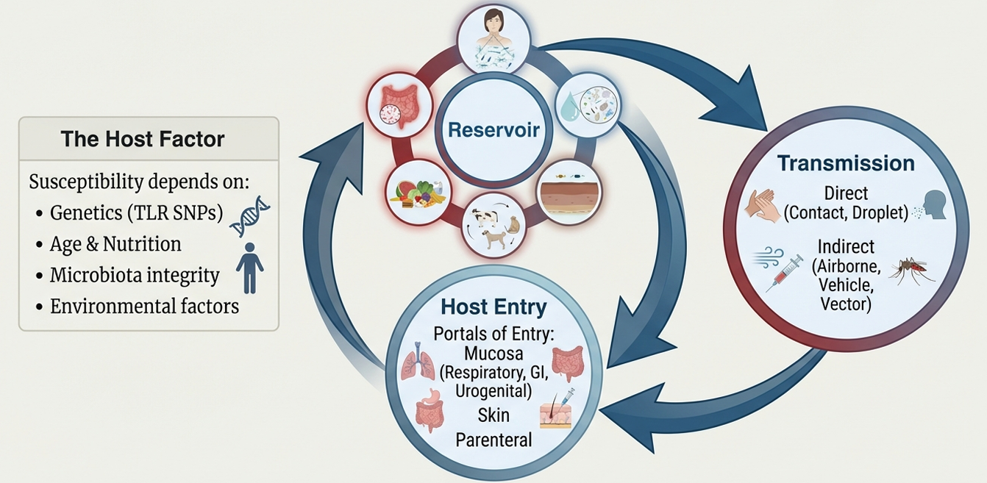
Stages of Bacterial pathogenesis – Exposure

Slide 16
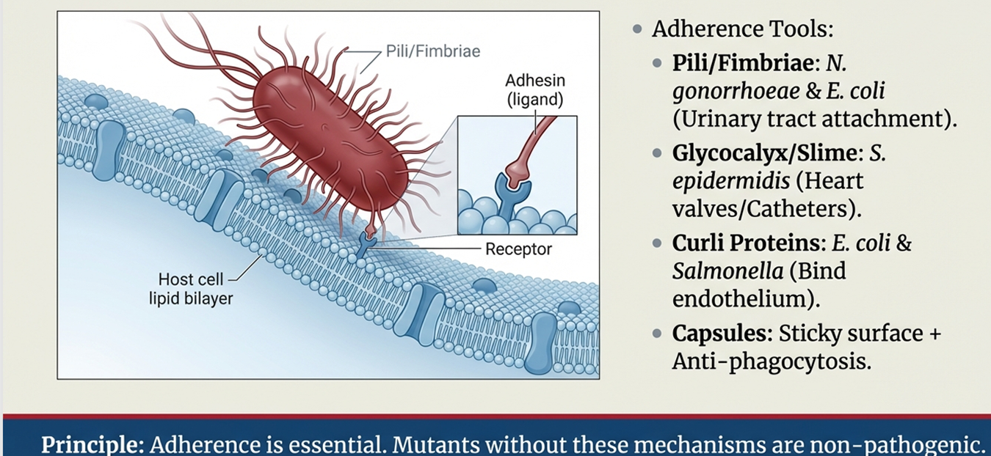
Stages of Bacterial pathogenesis – Adherence
These structures are collectively called adhesins

Slide 17
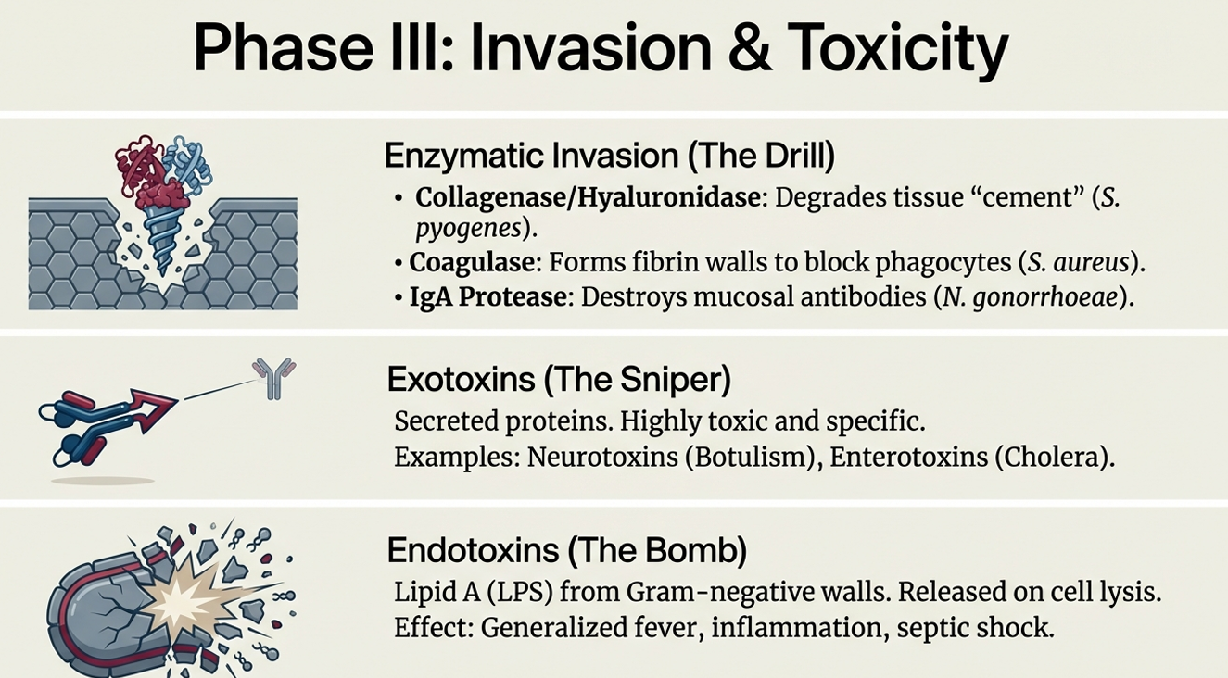
Stages of Bacterial pathogenesis – Invasion and Toxicity

Slide 18
Bacterial Pathogenesis - Immunopathogenesis
In certain diseases, such as rheumatic fever and acute glomerulonephritis, it is not the organism itself that causes the symptoms of disease but the immune response to the presence of the organism.
In rheumatic fever, antibodies are formed against the M protein of S. pyogenes, which cross-react with joint, heart, and brain tissue.
Inflammation occurs, resulting in the arthritis, carditis, and chorea that are the characteristic findings in this disease
Some bacterial infections are associated with cancers
Cytokine Storm mechanisms

Slide 19
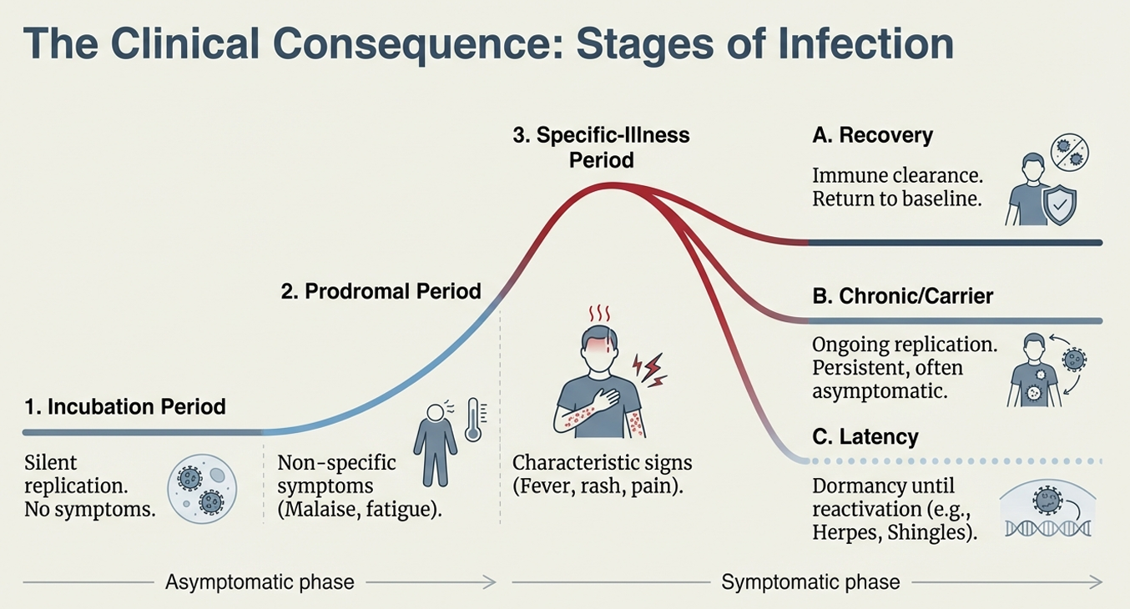
Typical Infectious Disease Stages

Slide 20
System-based Bacterial Pathogens
Bacterial infections are best approached by site of infection (clinical syndrome) rather than memorizing organisms
Where is the site, common organisms at this site, how is it transmitted and who is at risk
Determinants of the likely pathogen, age and immune status of the host, community vrs hospital acquired
We will now examine key bacterial pathogens based on each organ system and the diseases they cause

Slide 21
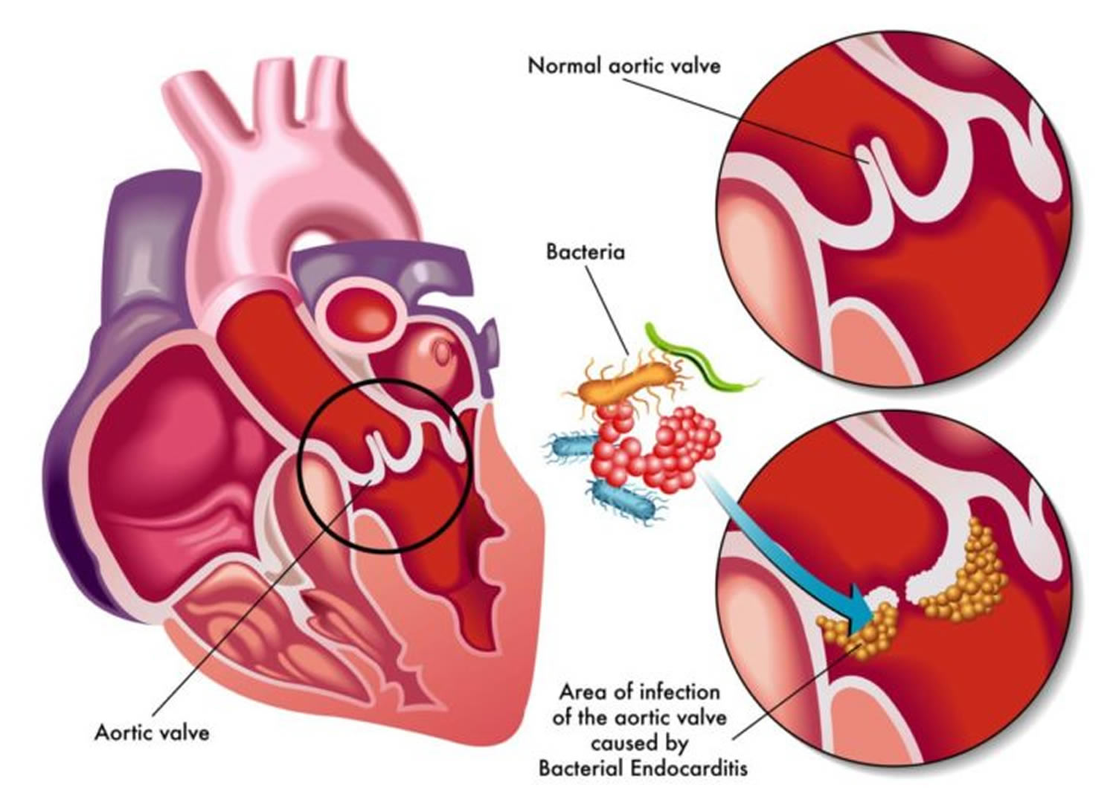
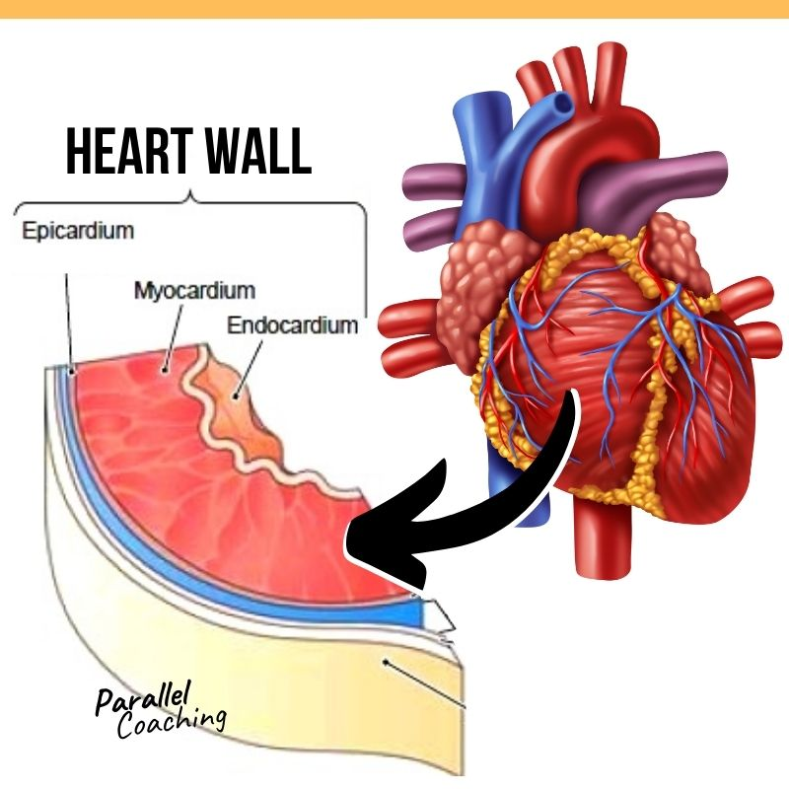
Cardiac bacterial disease – Endocarditis

Slide 22
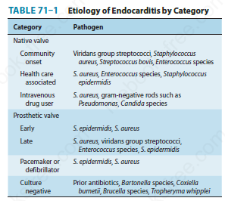
Endocarditis – Pathogens

Slide 23
Endocarditis
Diagnosis is made by
History and examination findings
Microbiological investigations – blood culture – at least 2 samples taken 12 hours apart
Radiological findings - Echocardiography
Treatment is mainly medical usually with weeks of intravenous anti-biotics, occasionally, surgery may be required.

Slide 24
OTHER CARDIAC INFECTIONS
Other cardiac infections include Pericarditis and Myocarditis
Myocarditis
Viral pathogens are thought to be the predominant cause of infectious myocarditis, although many cases are idiopathic.
Coxsackie viruses are the most common cause, although cytomegalovirus, Epstein–Barr virus, parvovirus B19, and influenza virus have been implicated.
Other pathogens include Trypanosoma cruzi, the agent of Chagas’ disease, and Trichinella spiralis
Pericarditis refers to inflammation of the pericardium

Slide 25
Other Cardiac infections- Pericarditis
Mycobacterium tuberculosis is one of the most common infectious causes of pericarditis worldwide.
Other infectious causes of pericarditis include fungi and viruses
Among viral infections, Coxsackie virus and echovirus are most common, although human immunodeficiency virus and cytomegalovirus can cause pericarditis as well.

Slide 26
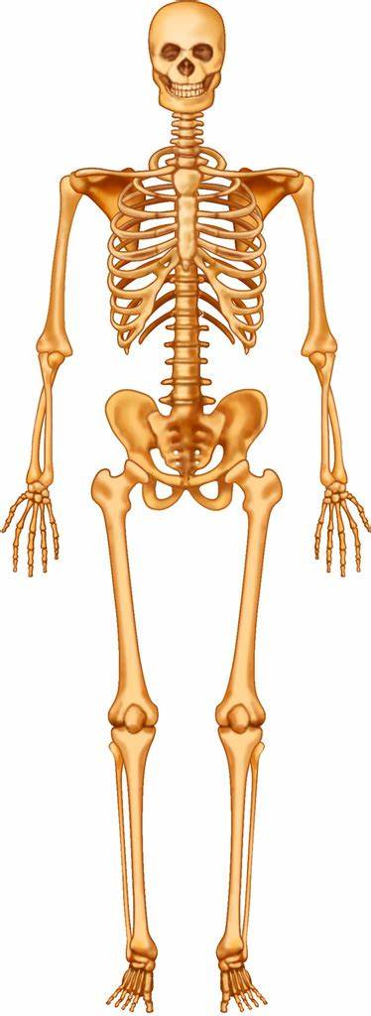
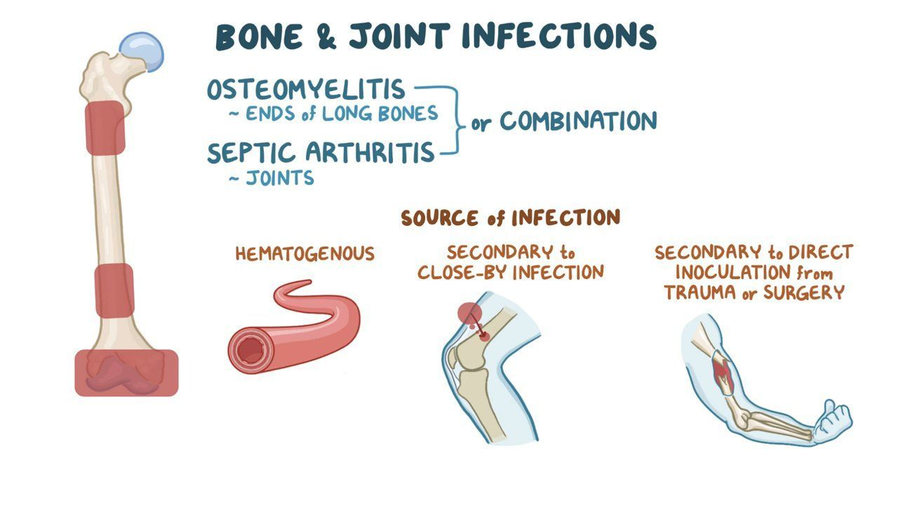
BONE AND JOINT DISEASES

Slide 27
Bone and Joint Diseases – Osteomyelitis
Clinical manifestation
The most characteristic clinical manifestations are bone pain and localized tenderness at the site of infection.
Most patients also have constitutional symptoms such as fever, night sweats, and fatigue
In acute osteomyelitis, the symptoms occur abruptly and progress rapidly, whereas in chronic osteomyelitis, the course is more indolent.
In chronic osteomyelitis, necrosis of the bone occurs.

Slide 28
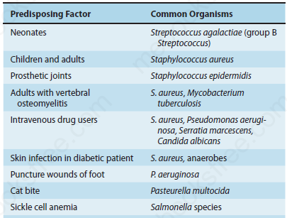
Bone and Joint Diseases – Osteomyelitis
Organisms Causing Osteomyelitis with Various Predisposing Factors

Slide 29
Bone and Joint Diseases – Osteomyelitis
A microbiologic diagnosis of acute osteomyelitis is most consistently made by culture of a specimen (aspirate, biopsied tissue) of the bone lesion.
Supportive blood cultures are positive in approximately half of cases.
Radiologic imaging is mostly employed in diagnosing chronic osteomyelitis
Treatment
involves use of bactericidal anti-biotics that penetrate soft tissue and bone for weeks to months eg Clindamycin
Surgical debridement is often necessary in chronic osteomyelitis

Slide 30
Bone and Joint Diseases – Septic Arthritis
Infectious (septic) arthritis is an infection of the joints. The terms infectious or septic are used to distinguish these infections from immune-mediated arthritis, such as rheumatoid arthritis.
Organisms typically reach the joint via the bloodstream from a skin site.
Clinical manifestation
The acute onset of an inflamed joint. Fever is often present.
On physical examination, the affected joint is red, warm, and swollen, and a joint effusion (fluid in the joint) is typically present.
Reluctance to use a joint, especially in a child, may be a sign of infectious arthritis.

Slide 31
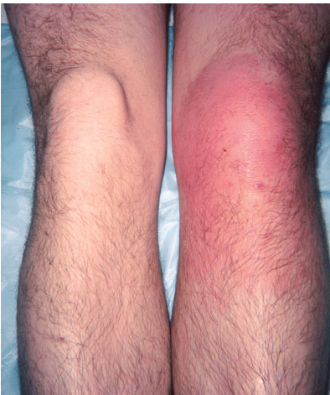
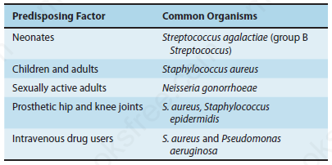
Bone and Joint Diseases – Septic Arthritis
Organisms Causing Infectious Arthritis with Various Predisposing Factors
Septic arthritis of knee

Slide 32
Bone and Joint Diseases – Septic Arthritis
Diagnosis
Visualization of the organisms in the Gram stain of joint fluid is used to guide empiric therapy.
A microbiologic diagnosis of infectious arthritis is typically made by culture of a specimen of the joint fluid. Blood cultures are positive in less than 30% of cases.
Treatment
Prompt antibiotic treatment is required for optimal recovery
Untreated infectious arthritis can lead to joint destruction and loss of mobility
Removal of joint fluid via arthrocentesis and/or surgical drainage is an important adjunct to antibiotics.

Slide 33
Central Nervous System Infections
Central nervous system (CNS) infections are often life threatening and can have severe sequelae.
These infections cause inflammation and oedema within the unyielding cranium, resulting in damage to brain tissue and loss of function.
Bacteria and viruses are the commonest etiologic agents, but fungi, protozoa, and helminths also cause these infections

Slide 34
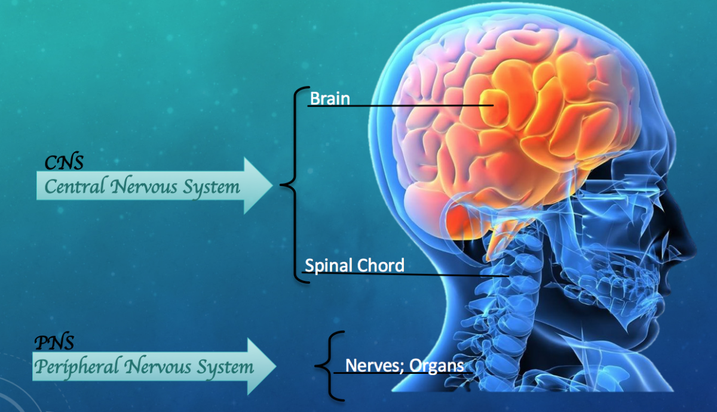
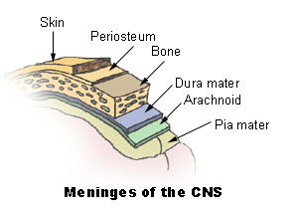
Central Nervous System Bacterial Infections
MENINGITIS
Inflammation of the meninges – the membranes that cover the brain and spinal cord.
Typically, bacterial meningitis reflects infection of the arachnoid mater and the CSF in both the Subarachnoid space and the ventricles

Slide 35
CNS INFECTION - MENINGITIS
Acute Meningitis Pathogens
The most common bacterial cause of acute meningitis overall is S. pneumoniae.
However, Streptococcus agalactiae (group B Streptococcus) predominates in neonates, and N. meningitidis is common in teenagers and young adults
Haemophilus influenzae type B used to be an important cause in young children, but the widespread use of the conjugate polysaccharide vaccine has greatly decreased its incidence.
Listeria monocytogenes is reasonably common in the very young, the very old, and in immunocompromised patients and pregnant women
Subacute or Chronic Meningitis
Mycobacterium tuberculosis is the leading cause of subacute/chronic bacterial meningitis

Slide 36
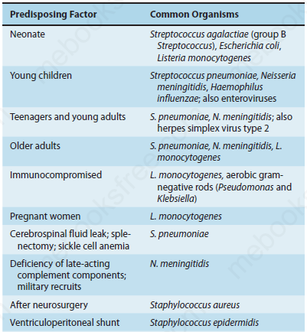
CNS INFECTION – BACTERIAL MENINGITIS

Slide 37
INVESTIGATORY TOOLS FOR CNS INFECTIONS
History and examination are the first types available to the clinician in CNS infections investigation
Radiological (mainly Computed Tomography Scan and Magnetic Resonance imaging), Microbiological and to some extent Serology are the mainstay of CNS infections investigations.
The samples mostly utilised in microbiological or serological investigation of CNS infections are Cerebro-spinal Fluid (CSF) and blood.

Slide 38
CNS INFECTIONS - CSF ANALYSIS
CSF obtained for analysis;
Gram stain
Bacterial culture
cells ( for both cell type and number; neutrophils or lymphocytes),
Protein concentration,
Glucose concentration
Other appropriate tests ( eg Rapid Serologic tests, PCR ) depending upon concern for possible etiologies
Analysis of spinal fluid can distinguish between acute bacterial meningitis and viral meningitis.

Slide 39
CSF ANALYSIS - MENINGITIS
GRAM STAIN
Gram stain should be routinely performed on all CSF samples from patients with suspected Meningitis
It has advantage of suggesting bacterial aetiology one day or more before culture results are available.
Gram positive diplococci suggest pneumococcal infection
Gram negative diplococci suggest meningococcal infection
Small pleomorphic Gram negative coccobacilli suggest Haemophilus influenzae infection
Gram positive rods and coccobacilli suggest Listerial infection
Acid Fast Bacillus stain for TB meningitis

Slide 40
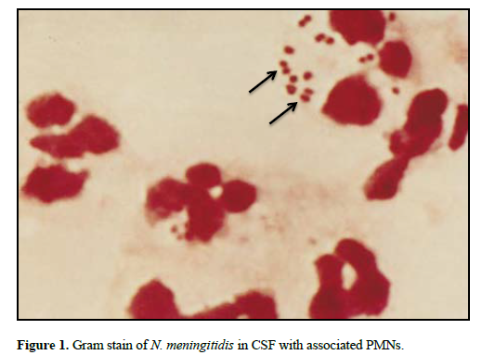
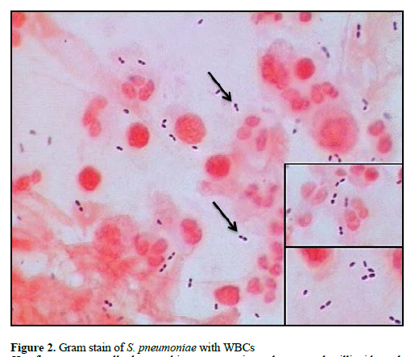
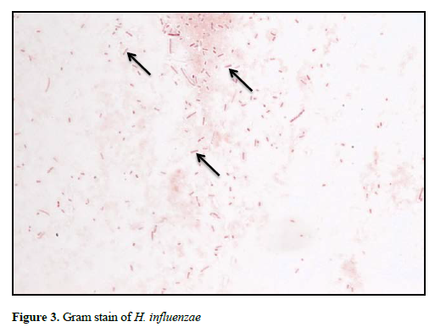
Gram Stain

Slide 41
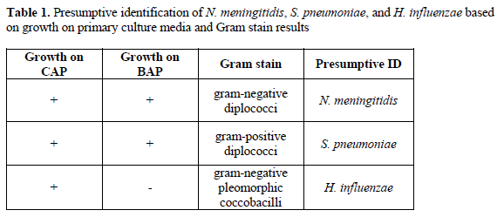
PRESUMPTIVE DIAGNOSIS BACTERIAL MENINGITIS
Presumptive Diagnosis

Slide 42
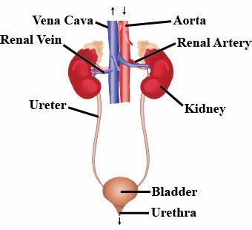
Urinary Tract Bacterial Infections
Urinary tract infections are a group of common diseases that occur predominantly by ascension of normal enteric flora through the urethra into the bladder.
These infections more frequently affect women due to anatomic differences including a shorter urethra.
Cystitis is an infection of the bladder
Pyelonephritis is an infection of the kidney(s). “Pyelo” refers to the renal pelvis, and “nephritis” means inflammation of the kidney.

Slide 43
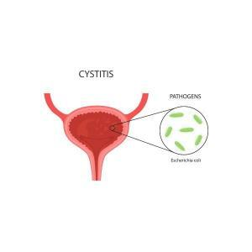
Urinary Tract Infections
Clinical manifestations of cystitis include dysuria (pain with urination); frequent, low volume urination; suprapubic tenderness and gross hematuria.
Pyelonephritis typically present with fever, flank pain, nausea, and vomiting.
Escherichia coli is by far the most common cause of urinary tract infections, especially cystitis.
Other enteric gram-negative rods such as Klebsiella species and Proteus species are regular culprits.
Gram-positive pathogens include Enterococcus species and Staphylococcus saprophyticus. Staphylococcus saprophyticus is common in young women.
Mycobacterium tuberculosis may occasionally cause pyelonephritis

Slide 44
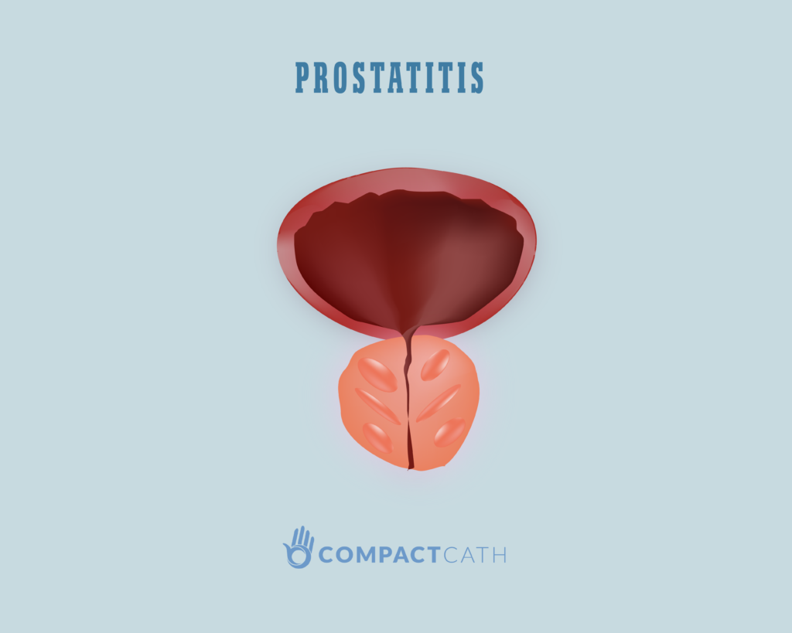
Urinary Tract Infections
Prostatitis is inflammation of the prostate, most often caused by bacterial infection.
Infection most frequently occurs via the urethra then into to the prostatic ducts. However, hematogenous seeding of the prostate can occur as well
Clinical Manifestations
Acute prostatitis may present with acute onset of fever, dysuria, urinary frequency, and severe pain with palpation of the prostate.
Patients may be very ill and can present with severe sepsis.
In contrast, chronic prostatitis presents with more subacute onset of dysuria, frequency, urinary hesitancy, and pelvic discomfort
In younger patients, Neisseria gonorrhoeae and Chlamydia trachomatis are the most common causes of prostatitis
Enteric bacteria, such as E. coli, are the predominant pathogens in older patients.
When hematologic seeding occurs, S. aureus is a common cause

Slide 45
Urinary Tract Infections - Diagnosis
Urine microscopy
Microscope to look at urine.
In patients with urinary tract infections, one can often find pyuria (elevated white blood cells [WBCs] in urine) and hematuria (red blood cells in urine), and sometimes bacteria can be seen.
The presence of WBC casts indicates pyelonephritis rather than cystitis.
A urine sample that has abundant squamous epithelial cells suggests that it is contaminated, and the results of the culture are not reliable.
Urine dipsticks
Different chemicals reagents on a strip that is dipped in urine to diagnose urinary tract diseases.
Certain dipstick test results are suggestive of infection, namely positive leukocyte esterase and positive nitrite
The positive nitrite occurs from the conversion of nitrate to nitrite by Enterobacteriaceae

Slide 46
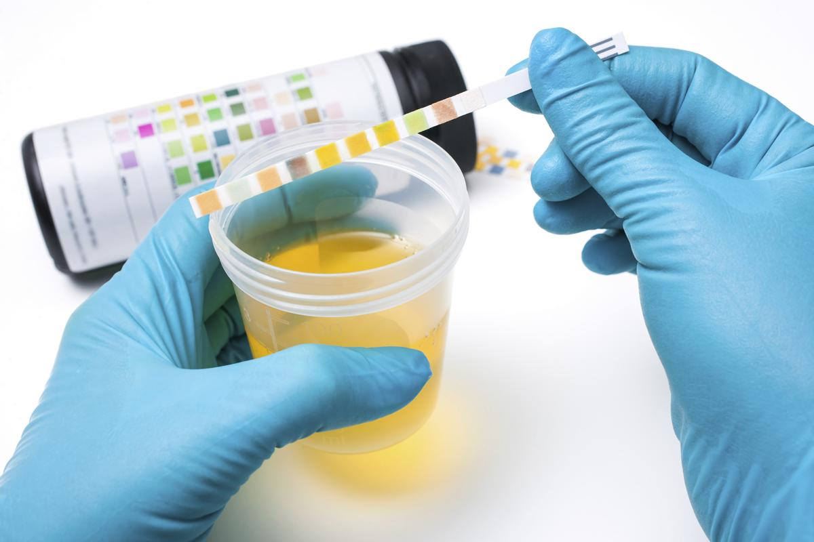
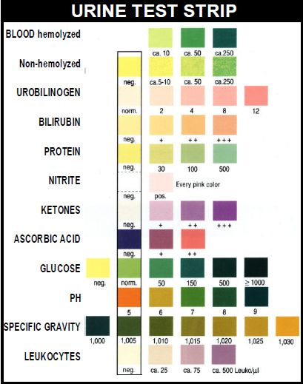
URINARY TRACT INFECTIONS – Diagnosis dipstick

Slide 47
URINARY TRACT INFECTIONS- Diagnosis
Urine culture
allows identification of the organism causing infection.
Urine in the bladder is normally sterile.
Because contamination of samples can occur as urine passes through the outer third of the urethra, a numeric threshold of colony-forming units (CFUs) per milliliter has been established to confirm infection.
In samples obtained from a midstream void, ≥1 × 105 CFU/mL is consistent with infection
Either a voided midstream urine specimen or a specimen obtained by bladder catheterization can be used for urine culture

Slide 48
QUESTIONS

Slide 49
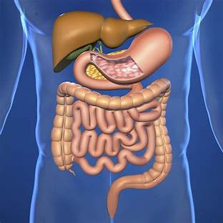
Gastrointestinal Tract Infections
Infections with a variety of agents can occur in any part of the gastrointestinal (GI) tract from the mouth to the anal canal.
Infections can range in severity from self-limited to life-threatening.
Infections are typically caused by the ingestion of exogenous pathogens in sufficient quantities to evade host defences – disease is caused by multiplication, toxin production, or invasion through the gastrointestinal mucosa to reach the bloodstream and other tissues.
Members of the normal flora of the GI tract can cause disease.

Slide 50
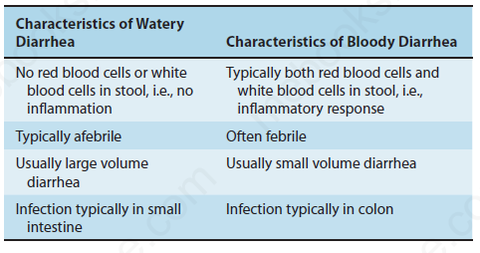
GASTROINTESTINAL TRACT INFECTIONS
Characteristics of Watery Diarrhoea compared with Bloody Diarrhoea

Slide 51
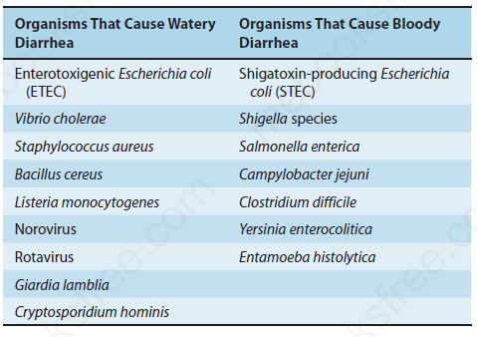
GASTROINTESTINAL TRACT INFECTIONS
Important Organisms That Typically Cause Either Watery or Bloody Diarrhoea

Slide 52
Gastrointestinal Bacterial Diseases
Usually stool specimen is used in Gastrointestinal bacterial disease diagnoses
H. pylori stool antigen test in Gastritis/PUD
The culture medium is selected to suit the organism of interest
eg MacConkey for Enterobacteriaceae
Salmonella and Shigella Agar
Selenite F Broth for Salmonella enrichment
TCBS for Vibrio Cholerae
Skirrow medium for Campylobacter

Slide 53
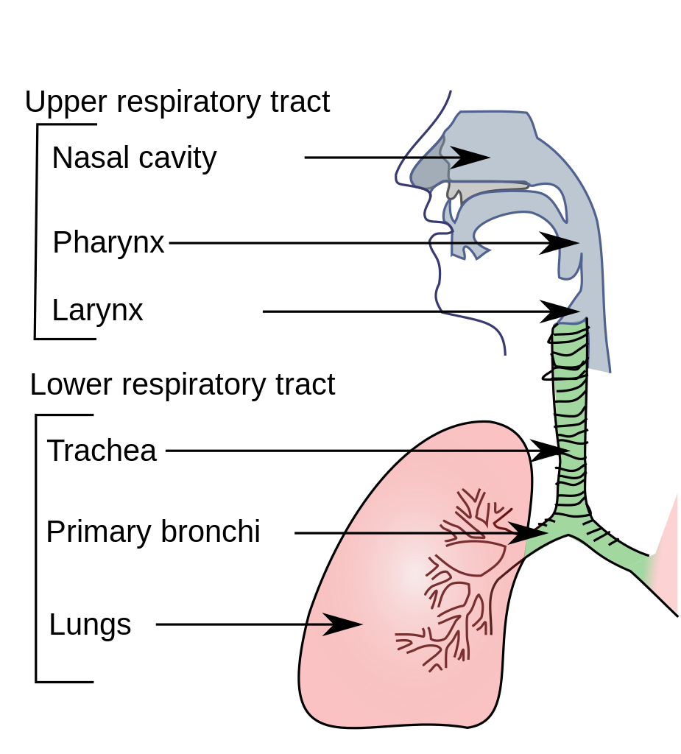
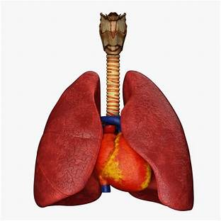
Respiratory Infections

Slide 54
Upper Respiratory Tract Infection
Bacterial aetiologies of some of the common upper respiratory tract infections may be primary or superinfections of the original viral processes
Otitis media
Otitis media is an infection of the middle ear caused by either viruses or bacteria.
Any process that leads to eustachian tube obstruction can result in fluid retention and concomitant infection of the middle ear
Patients present with ear pain and pressure, often accompanied by an upper respiratory tract infection. In infants, the ear pain may manifest as ear pulling.
Common bacterial aetiologies include Streptococcus pneumoniae and Haemophilus influenzae

Slide 55
Upper Respiratory Tract Infection - Pharyngitis
About 10% of cases of pharyngitis are caused by Streptococcus pyogenes (group A Streptococcus [GAS]).
Streptococcal pharyngitis (strep throat) is important because poststreptococcal immune sequalae, such as rheumatic fever, may occur
Patients will complain of sore throat that is worse when swallowing. Fever may also be present
Streptococcus pyogenes (GAS) is the most important bacterial cause
Pharyngitis caused by Neisseria gonorrhoeae is likely to be the result of sexual activity and, if it occurs in children, is considered as a sign of child abuse.
In certain countries where the diphtheria vaccine is not widely used, Corynebacterium diphtheriae is a significant cause of pharyngitis, often accompanied by a pseudo-membrane.
S. pneumoniae and H. influenzae colonize the oropharynx but they do not cause pharyngitis

Slide 56
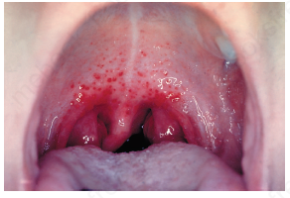
Upper Respiratory Tract Infection - Pharyngitis
Pharyngitis caused by Group A Beta Haemolytic Streptococcus
(Note inflamed pharynx, tonsils, and palatal petechiae)

Slide 57
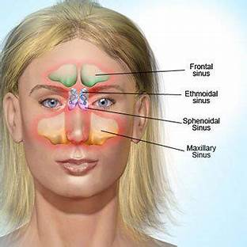
Upper Respiratory Tract Infection
Sinusitis
Sinusitis is inflammation of the paranasal sinuses.
It can be either acute or chronic. Acute infections are considered those with symptoms lasting less than 4 weeks.
Impaired mucociliary clearance caused by viral infection or allergic rhinitis can obstruct the orifice of the sinus.
Clinical manifestations include purulent nasal discharge, nasal congestion, facial or sinus pain, decreased sense of smell, and fever. Headache and malodorous breath may be present.

Slide 58
UPPER RESPIRATORY TRACT INFECTION
Epiglottitis
is an inflammation of the epiglottis.
Clinical manifestations include rapidly worsening sore throat and odynophagia (pain on swallowing) or dysphagia (difficulty in swallowing). Pain may be out of proportion to physical examination findings.
Airway obstruction can occur in severe cases. Epiglottitis in young children should be treated as a medical emergency.
Haemophilus influenzae type B is, by far, the most common cause, although the widespread use of the vaccine against H. influenzae type B has greatly reduced the incidence of epiglottitis.
Less common pathogens include other H. influenzae types, S. pneumoniae, S. pyogenes
Treatment is with anti-biotics; often intravenous Ceftriazone

Slide 59
UPPER RESPIRATORY TRACT INFECTION
Other infections of the upper respiratory tract include
Common cold
Rhinoviruses (more than 100 serotypes) are the most common aetiology (up to 50%). Coronaviruses, adenoviruses, and enteroviruses such as Coxsackie viruses are other causes. Viruses such as parainfluenza virus and respiratory syncytial virus are also possible causes of the common cold, although they primarily cause other diseases (croup and bronchiolitis, respectively
Croup
inflammation of the larynx, trachea, and large bronchi (laryngotracheobronchitis)
Parainfluenza viruses, especially type 1, are the most common cause. Respiratory syncytial virus and influenza virus account for 1% to 10% of cases.
Laryngitis
Laryngitis is inflammation of the vocal folds of the larynx
Parainfluenza viruses and rhinoviruses are the most common causes of laryngitis
Bacteria such as S. pyogenes, M. catarrhalis, and H. influenzae have also been isolated.

Slide 60
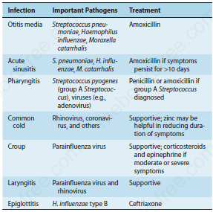
UPPER RESPIRATORY TRACT INFECTION
Common Infections of the Upper Respiratory Tract

Slide 61
Infections Of The Lower Respiratory Tract
Bronchitis
Bronchitis is a self-limited inflammation of the bronchi.
Acute bronchitis must be distinguished from chronic bronchitis in which patients have a cough for more than 3 months.
Respiratory viruses are the most common pathogens
Bacterial pathogens are not thought to play a significant role in acute bronchitis
Bronchiolitis
Bronchiolitis is inflammation of the bronchioles—the small airways less than 2 mm in diameter.
RSV is the most common pathogen.
Other aetiologies include influenza virus, parainfluenza virus, adenovirus, coronavirus, rhinovirus, and human metapneumovirus.
Viruses are the main aetiology of bronchiolitis. Bacteria are not thought to be involved.

Slide 62
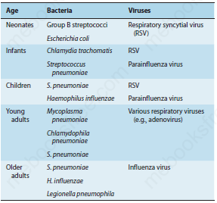
INFECTIONS OF THE LOWER RESPIRATORY TRACT
Pneumonia – Pathogens
Bacterial and Viral Causes of Community-Acquired Pneumonia by Age (Listed in Order of Frequency)

Slide 63
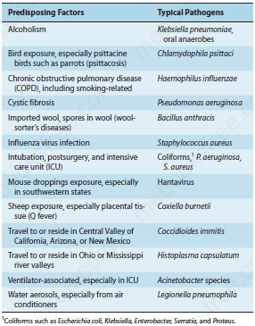
INFECTIONS OF THE LOWER RESPIRATORY TRACT
Predisposing Factors Associated With Typical Pathogens Causing Community-Acquired Pneumonia

Slide 64
INFECTIONS OF THE LOWER RESPIRATORY TRACT
Pneumonia – Diagnosis
The “gold standard” for a diagnosis of pneumonia is an infiltrate on a plain chest radiograph
Sputum analysis for Gram stain and culture and blood cultures may be helpful in the hospitalized patient
Pneumonia caused by M. tuberculosis is diagnosed by acid-fast stain of sputum and culture on mycobacterial medium. A PCR assay done directly on sputum is available also.
Pneumonia caused by Legionella pneumophila is often diagnosed by urinary antigen.
PCR tests for various respiratory pathogens such as M. pneumoniae, C. pneumoniae, influenza virus, and RSV are useful in special circumstances.
Treatment is mainly anti-biotics tailored towards the possible organisms

Slide 65
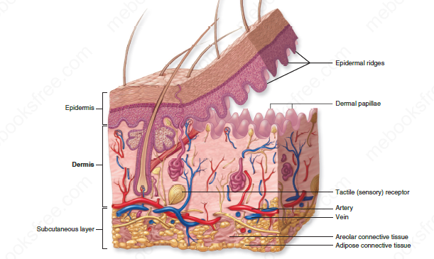
Skin And Soft Tissue Infections
Layers of the skin and subcutaneous tissue

Slide 66
Skin And Soft Tissue Infections
Impetigo
Impetigo is an infection of the epidermal layer of skin
There are two modes of acquisition of impetigo, primary infection that occurs in otherwise normal skin or secondary impetigo, which occurs following a break in normal skin integrity. Bacteria invade into the epidermal layer and cause local damage.
Staphylococcus aureus and S. pyogenes are the two main pathogens that cause impetigo.
In neutropenic patients, a clinical syndrome termed ecthyma gangrenosum which may be confused with impetigo is due to disseminated Pseudomonas aeruginosa infection.

Slide 67
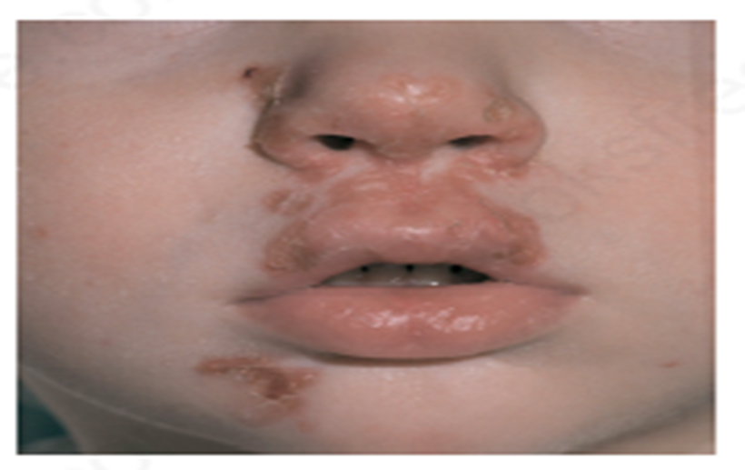
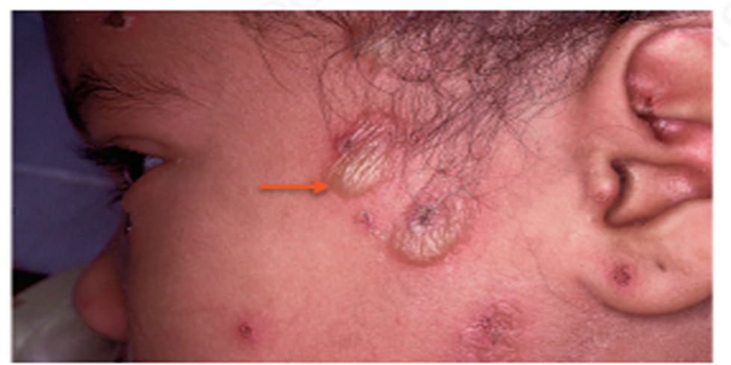
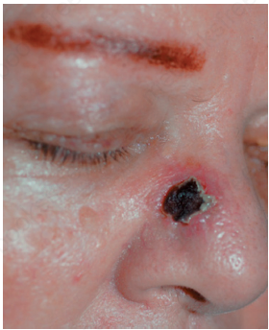
Skin And Soft Tissue Infections
Non – bullous impetigo Bullous impetigo Ecthyma

Slide 68
Skin And Soft Tissue Infections
Cellulitis and Erysipelas
Cellulitis and erysipelas are infections of the dermis.
These infections occur following a break in normal skin integrity.
Cellulitis and erysipelas both involve the dermis, but erysipelas involves the upper dermis and superficial lymphatics and sharply demarcated, whereas cellulitis involves the deeper dermis and subcutaneous fat and lesion is not sharply demarcated
Beta-hemolytic streptococci are the most common pathogens to cause these infections, with S. pyogenes and Streptococcus agalactiae being some of the most common species.
Staphylococcus aureus can also cause this type of infection.

Slide 69
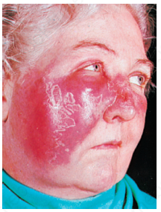
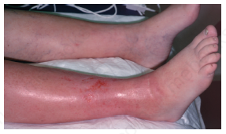
Skin And Soft Tissue Infections
Erysipelas. Note markedly inflamed lesion with
clearly demarcated border on right cheek, across the nose to the left
cheek.
Cellulitis. Note diffuse inflammation on right leg
including the skin over the ankle and dorsum of the foot.

Slide 70
Skin And Soft Tissue Infections
Folliculitis
Folliculitis is a superficial infection of the hair follicles
Bacteria and purulent material accumulate in hair follicles in the epidermal layer of the skin.
Folliculitis presents with pinpoint erythema around individual hair follicles. A small amount of purulence may be seen.
This can be seen in an isolated body area or throughout the skin
Staphylococcus aureus is the most common cause of folliculitis.
Pseudomonas aeruginosa can also cause folliculitis and is associated with the use of unchlorinated hot tubs.

Slide 71
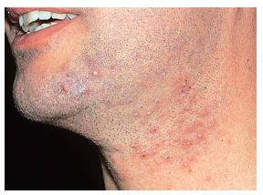
Folliculitis
Diagnosis is made clinically, but if purulent material is present, it can be cultured.
Treatment
Folliculitis often resolves on its own, and treatment is not needed. Warm compresses or topical antibiotics can be considered in selected cases
Prevention
Handwashing and covering draining lesions should be used to prevent spread of bacteria.
Avoiding unchlorinated hot tubs is recommended

Slide 72
SKIN AND SOFT TISSUE INFECTIONS
Skin Abscess (Furuncle and Carbuncle)
A skin abscess is an infection of the dermis and deeper layers of skin that contains purulent material
Abscesses occur when pathogens enter a break in the skin following trauma or when they spread from infected hair follicles.
When a single follicle is infected and tracks down into the dermis, it is termed a furuncle (“boil”), and when multiple infected hair follicles coalesce, it is termed a carbuncle.
Occasionally an abscess may develop following hematogenous dissemination of an infection.

Slide 73
SKIN AND SOFT TISSUE INFECTIONS
Skin Abscess (furuncle and carbuncle)
A carbuncle is a larger, more serious lesion than a furuncle. It is composed of several adjacent furuncles that have coalesced into an inflamed, indurated lesion that typically extends deep into subcutaneous tissue.
Staphylococcus aureus is, by far, the most common cause of skin abscesses (more than 75% of cases).
Gram stain and culture of purulent material obtained from the abscess allows for diagnosis
The primary treatment for abscesses is incision and drainage

Slide 74
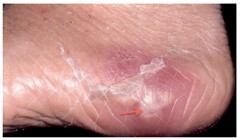
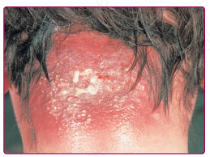
SKIN AND SOFT TISSUE INFECTIONS
Abscess. Note localized area of inflammation
containing a central core of yellowish pus (arrow) on medial aspect
of foot.
Carbuncle. Note multiple furuncles that
have coalesced to form a large area of inflammatory lesion

Slide 75
SKIN AND SOF TISSUE INFECTIONS
Necrotizing Soft Tissue Infections (Necrotizing Fasciitis/Myonecrosis)
Necrotizing fasciitis is a necrotizing infection of the deep structures of the skin including the underlying fascia.
In myonecrosis, the underlying muscle becomes necrotic
Maybe polymicrobial (more common) or monomicrobial.
Monomicrobial infection is most often due to S. pyogenes but can also be caused by Vibrio vulnificus following trauma in brackish water
Necrotizing soft tissue infections are a medical emergency, and treatment requires a combination of surgical debridement of infected tissue and antibiotic therapy.

Slide 76
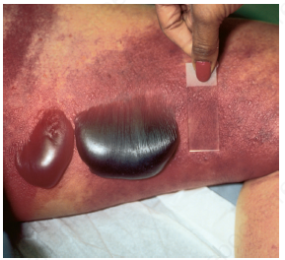
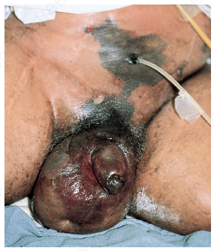
SKIN AND SOFT TISSUE INFECTIONS
Necrotizing fasciitis. Note two large hemorrhagic
bullae surrounded by dusky red inflamed tissue
Fournier’s gangrene. Note gangrene of the
genitalia and skin of lower abdomen.

Slide 77
PELVIC INFECTIONS
Infections in the pelvic organs and surrounding structures comprise a heterogenous group of diseases.
They primarily affect sexually active women and men.
Many of the pathogens implicated are sexually transmitted, so an important aspect of management is partner notification and treatment, as well as patient education regarding safe sexual practices.

Slide 78
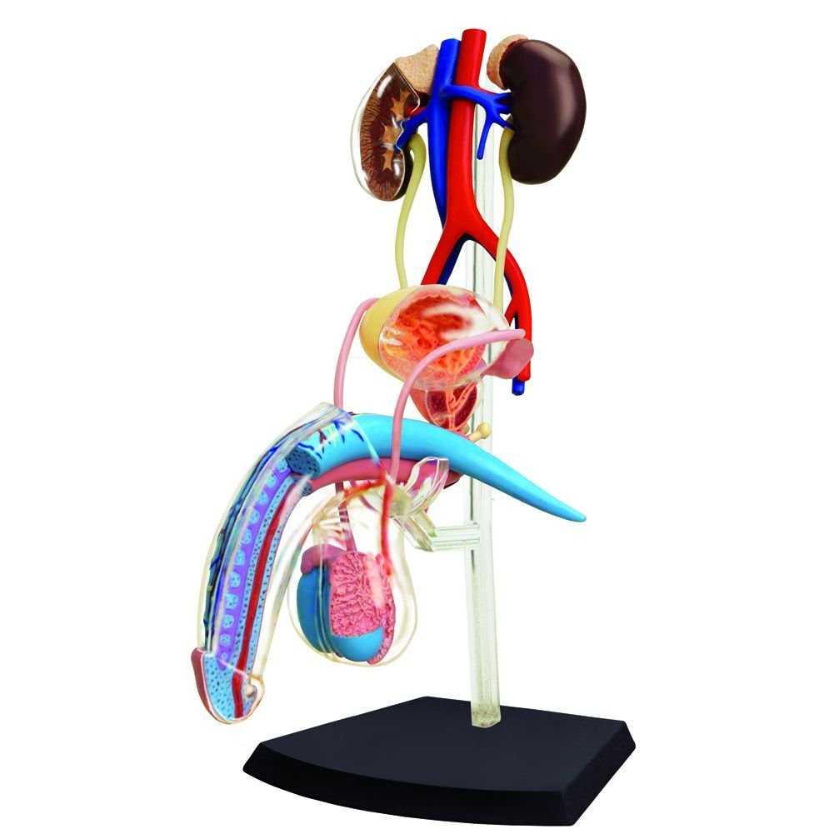


PELVIC INFECTIONS

Slide 79
Reproductive Tract Diseases-Genital tract ulcers
Genital ulcer disease manifests as a breach in the skin or mucosa of the genitalia, usually caused by a sexually transmitted infection.
Herpes simplex virus type 2 (HSV-2) is the most common aetiology in most geographic areas, followed by syphilis and chancroid.
HSV-2 (causes genital herpes), Treponema pallidum (causes primary syphilis/chancre), and H. ducreyi (causing chancroid).
Less common pathogens include Chlamydia trachomatis (causing lymphogranuloma venereum) and Klebsiella granulomatis (causing granuloma inguinale, also known as donovanosis).

Slide 80


Reproductive Tract Diseases -Genital Ulcers
Genital herpes (HSV2) Chancre(Primary Syphilis)

Slide 81

Genital Ulcers: Clinical Features, Diagnosis, and Treatment

Slide 82
Reproductive Tract Diseases
Vaginitis
Vaginitis is inflammation of the vagina that can result in discharge, itching, and pain.
Common causes of vaginitis are candidiasis, trichomoniasis, and bacterial vaginosis.
Bacterial vaginosis is a polymicrobial infection, it does not appear to be a sexually transmitted disease.
Trichomoniasis, on the other hand, is a sexually transmitted disease.

Slide 83

Reproductive Tract Diseases - Vaginitis
Vaginitis: Clinical Features, Diagnosis, and Treatment

Slide 84

Reproductive Tract Diseases
Cervicitis
Cervicitis is inflammation of the uterine cervix.
Acute cervicitis is usually due to a sexually transmitted infection caused by either C. trachomatis or Neisseria gonorrhoeae or both.
A large proportion of women with cervicitis are asymptomatic, in many cases, cervicitis is detected on speculum examination following routine screening
On physical examination, increased friability of the cervical tissue after a swab is inserted may be a clue to the diagnosis.
The usual pathogens are C. trachomatis or N. gonorrhoeae.
Other less common aetiologies include HSV and T. vaginalis.
Notes:
C. trachomatis serovars D–K

Slide 85
Reproductive Tract Diseases
Pelvic Inflammatory Disease
Pelvic inflammatory disease (PID) is a polymicrobial infection of upper genital tract structures, namely the uterus, fallopian tubes, and ovaries.
When the endocervical canal barrier is compromised, vaginal bacteria can ascend into the normally sterile space of the upper genital tract (uterus, fallopian tubes, and ovaries).
A sexually transmitted infection affecting the cervix can initiate the processes leading to PID
PID is primarily associated with N. gonorrhoeae and C. trachomatis, together with enteric gram-negative rods and anaerobes.
Patients can present with a range of symptoms, from lower back pain to fever, chills, lower abdominal pain, and cervical and adnexal tenderness.

Slide 86
Reproductive Tract Diseases
Urethritis
Urethritis is inflammation of the urethra.
It is usually caused by a sexually transmitted infection, particularly in sexually active men.
Dysuria is a common presenting complaint. Discharge from the urethra, pruritus, and burning are also common complaints.
Neisseria gonorrhoeae and C. trachomatis are the most common organisms implicated. Other organisms include Mycoplasma genitalium and T. vaginalis.
Urethral swab for staining, wet mount, Culture & sensitivity, PCR
Notes:
A non-infectious cause is Reiter’s syndrome, an autoimmune disease that includes urethritis, uveitis, and reactive arthritis

Slide 87

Reproductive Tract Diseases Urethritis
Thick purulent Urethral Discharge in Gonorrhoea

Slide 88
THANK YOU FOR YOUR ATTENTION
QUESTIONS

